Slide 1
FIT STOP
MANAGEMENT
TRAINER
MEMBERS

Slide 2
MANAGEMENT ACCESS
MANAGEMENT
TRAINER
Add , Modify & Delete
MEMBER
Add , Modify & Delete

Slide 3
TRAINER ACCESS
TRAINER
MEMBER
VIEW MEMBER OF HIS TRAINER

Slide 4
Login Page Flow
Login Page
Is
Management
Account?
Management Page
Get username & password
Is
Valid
Username & password?
Is
Trainer
Account?
Trainer Page
Flow
Yes Flow
No Flow

Slide 5




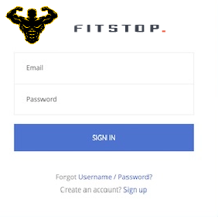






Notes:
LOGIN PAGE FOR MANAGEMENT AND TRAINER

